Slide 1

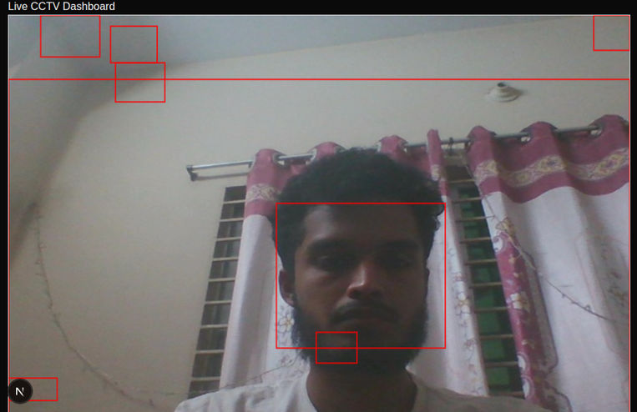
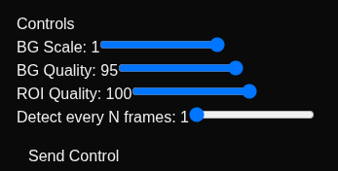

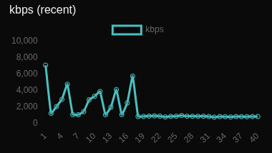
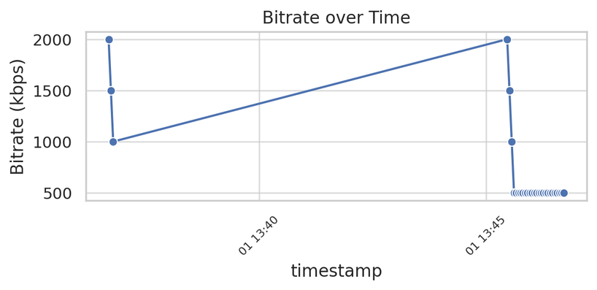
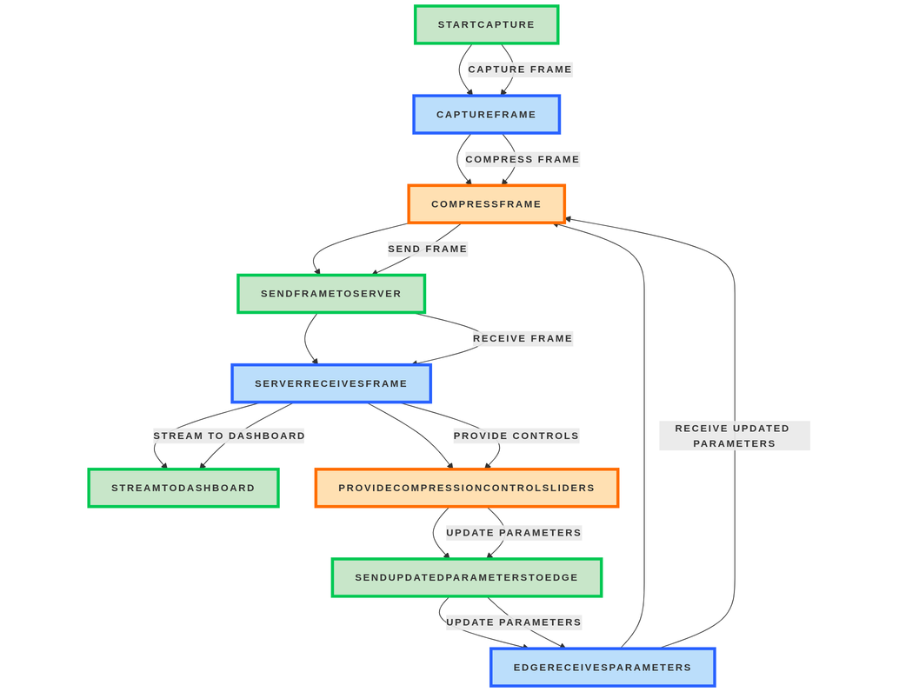
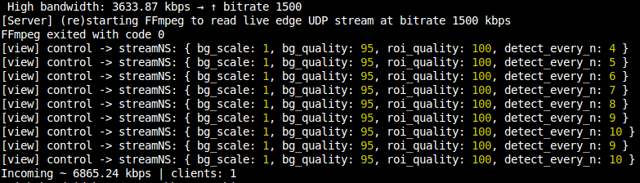
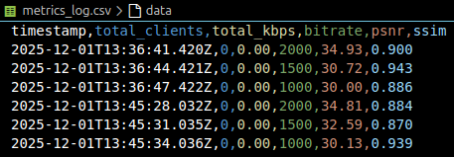
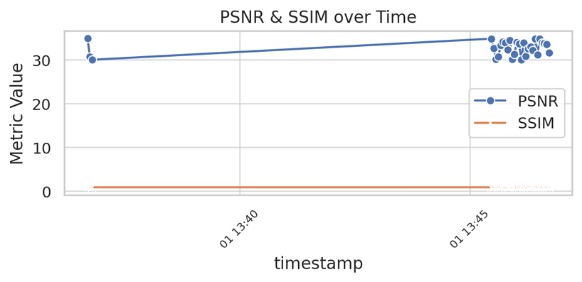




ADAPTIVE CCTV COMPRESSION SYSTEM USING DYNAMIC REGION OF INTEREST (ROI) CONTROL
Shakibul Islam Mostofa Main Uddin Jannatul Tabassum
DEPARTMENT OF CSE
BANGLADESH ARMY INTERNATIONAL UNIVERSITY OF SCIENCE AND TECHNOLOGY(BAIUST),CUMILLA
A.
Abstract
D.
Analysis & Results
An adaptive CCTV compression system that adjusts video quality and bitrate based on motion and ROI. Using OpenCV motion detection and FFmpeg encoding, it preserves important areas while reducing background data. The system includes an Edge Node (capture + ROI compression), a Server (connections + metrics), and a Dashboard (real-time bitrate/latency/FPS). A Python evaluator runs controlled tests (BG10_ROI70, BG50_ROI90) with timed logging. Results show 45–65% bandwidth reduction with stable PSNR/SSIM, providing a scalable, energy-efficient solution for smart surveillance and IoT environments.
Fig.03: Adaptive ROI-Based Motion Detection on Edge Node
Fig.04: User-Controlled Compression Dashboard with Live Metrics
Fig.05: Server-Side Adaptive Bitrate Log Showing Dynamic Parameter Updates
Fig.06: Bandwidth Monitoring: Instantaneous vs Trend Graph
B.
Structure
Fig.01: Structure of the proposed model
Fig.07: Real-Time Edge-to-Server Interaction with Motion-Aware Compression
C.
Methodology
Captured live video frames using Python (OpenCV).
Detected faces/hands with MediaPipe to mark ROI.
Split each frame into ROI and background regions.
Applied high-quality JPEG compression to ROI and low-quality JPEG to background.
Reconstructed frames using NumPy, generating the adaptive output.
Logged bitrate changes, control signals, and experiment data using Node.js server.
Visualized compression results and system behavior using sample outputs and experiment screenshots (Fig.02).
Fig.08: Metrics Log Data with Key Performance Indicators (KPIs)
Fig.09: Visualization of PSNR & SSIM Over Time
(a) (b) (c)
(d)
Fig.02: Compression performance (a) orginal.jpg, (b) roi_high_quality.jpg, (c) background_low_quality.jpg, (d) comparison_side_by_side.jpg
E.
Conclusion
This project demonstrates an efficient edge-based CCTV streaming system capable of real-time compression and adaptive control. It reduces network usage and improves performance for smart surveillance deployments. The architecture is scalable for use in IoT, smart cities, and low-resource environments.
Reference
[1] Chengzhi Wang, Peng Yang, “Compression Metadata-assisted RoI Extraction and Adaptive Inference”, arXiv:2503.24127v1 [cs.MM], 31 Mar 2025.
[2] Guo, Yejun, “[FFmpeg-devel] [PATCH V2 1/2] add support for ROI-based encoding”, Tue Dec 25 EET 2018.
[3] Jian Yang, Haixin Wang, Ittetsu Taniguchi, “aVCSR: Adaptive Video Compressive Sensing Using Region-of-Interest Detection in the Compressed Domain”, Jan.-Mar. 2024, pp. 19-32, vol. 31, DOI: 10.1109/MMUL.2023.3342062.
[4] I. Himawan, W. Song and D. Tjondronegoro, "Automatic region-of-interest detection and prioritisation for visually optimised coding of low bit rate videos," 2013 IEEE Workshop on Applications of Computer Vision (WACV), Clearwater Beach, FL, USA, 2013, pp. 76-82, doi: 10.1109/WACV.2013.6475002.

